Slide 1
Power BI Report Demo
By – Rashmi Raju Koparde

Slide 2
Key Performance Indicators
KPI | Formula | Reason
Total Sales | SUM(Sales) | Essential for understanding the total sales of division's market.
Total Profit | SUM(Profit) | Essential for understanding the total profit of division's market.
Profit Margin | SUM(Profit) / SUM(Sales) | Provides context to profit by showing efficiency. A high sales figure with a low or negative margin is a critical warning sign.
Total Loss | SUM(Negative Profit) | Essential for understanding the total loss of division's market.
Average Order Value (AOV) | SUM(Total Sales)/ SUM(Total No. Orders) | Measures the quality of sales transactions, not just the quantity
Return on Investment (ROI) per Order | SUM(Profit) / COUNTROWS(Orders) | Measures the average profitability of each transaction. Helps identify if the business is driven by many small orders or fewer, larger ones.
Sales/ Profit per Timeframe, Region, Category, sub-category, Discount, State | SUM(Sales) (Sliced by dimension) | Identifies top-performing and underperforming regions and product categories. Crucial for strategic resource allocation and marketing.
Repeat Customer Rate | Repeat Customer / Total Customer | This is a leading indicator of long-term health and customer satisfaction.

Slide 3
Design choices and how they will assist in decision-making
Design Choice | How it Assists in Decision-Making
Single-Page Dashboard | Provides a unified, at-a-glance view of the entire division's performance. Managers can quickly grasp the overall situation without navigating multiple pages, saving time and reducing complexity.
Top-Level KPI Cards | Offers an immediate performance summary. A leader can see in seconds if the division is profitable (Total Profit), efficient (Profit Margin).
Interactive Slicers and Filters | Empowers Managers to conduct their own analysis. The VP of Sales can filter to "West Region" and "Technology" to see how that specific segment is performing, enabling root-cause analysis without needing a new report.
Stacked Bar Chart: Sales by Timeframe and State | This is a workhorse visual for comparative analysis. It simultaneously answers two critical questions: 1) "How are sales trending over time?" and 2) "Which states are the primary drivers of that performance in each period?" This allows managers to quickly identify seasonal trends, state-specific anomalies, and the relative contribution of each state to the regional total, enabling targeted performance reviews and resource allocation.
Pie/Donut Chart: Sales by Region/Category | Provides an immediate, intuitive understanding of market composition. Stakeholders can instantly see the largest contributing regions or product categories to overall sales. This allows for quick, high-level strategic decisions about where to focus resources, without getting lost in detailed numbers.
Treemap for Profit by Sub-Category | Uses pre-attentive attributes (size and color) to instantly highlight the best and worst performers. The Head of Product can immediately see which product lines to invest in and which to review or discontinue.
Line Chart: Discount Impact Analysis | Reveals the crucial relationship between pricing strategy and financial outcomes. This chart is essential for answering the core question: "Are our discounts driving enough sales volume to justify the reduced profit margin?" Decision-makers can use this to identify the optimal discount level that maximizes profit, not just sales volume.

Slide 4
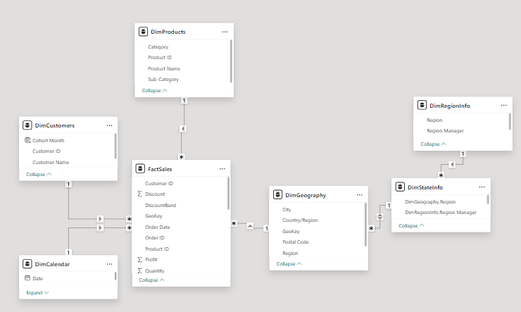
Data Model
We have built a Star Schema, which is the industry-standard data model for analytics and reporting. This design ensures high performance, accuracy, and ease of use for the end-users.
The model consists of:
One Fact Table (FactSales): The central table containing all the transactional data.
Four Dimension Tables (DimProducts, DimCustomers, DimGeography, DimCalendar): These tables describe the facts.
One Bridge Table (DimStateInfo): This table connects the geography data to the organization's management structure.
Our model ensures performance, accuracy, simplicity and security.
The DimStateInfo table is the foundation for our security model, allowing us to automatically filter data for each manager seamlessly.

